Slide 1
Wellness hub
Tallati Nikhil Bhushan
Harini Parsha

Slide 2
Problem statement
Modern life often complicates efforts to maintain a healthy lifestyle, with busy schedules making it difficult to track and balance physical activity, diet, and mental health. For example, a busy professional may find it challenging to keep track of their daily exercise, maintain balanced diet, and manage stress. Without a comprehensive tool to monitor these aspects, individuals may struggle to identify patterns and make informed decisions about their health. Existing health apps often focus on isolated aspects like diet tracking or workout logging, leaving users without a holistic view of their overall well-being.

Slide 3
Functional Requirements:
1. User Authentication and Authorization: - The system must allow users to register, log in, and log out. - User authentication should be managed through JWT tokens, ensuring secure access to the application.
2. User Management: - Users should be able to update their profile information, including username, email, password, age, gender, height, weight, and activity level. - The system should support CRUD operations for user data.
3. Diet Planning: - Users should be able to view and manage their diet plans. - The system should calculate daily calorie intake based on user preferences and activity levels. - The Diet Planner Service should interact with the Diet DB to store and retrieve diet-related information.

Slide 4
Functional Requirements:
4. Fitness Tracking: - Users should be able to log fitness activities, including activity type, duration, calories burned, and activity date. - The system should track daily activity summaries, including total calories burned and total duration of activities. - Fitness activities should be stored and managed within the Fitness DB.
5. Mental Health Assessments - The system should allow users to complete PHQ-9 and GAD-7 assessments. - User responses should be stored in the Mental Health DB. - The system should calculate and display results based on user responses.
6. API Gateway: - The API Gateway must route requests to appropriate backend microservices. - It should handle requests for authentication, user management, diet planning, fitness tracking, and mental health assessments.

Slide 5
Non-Functional Requirements
1. Security: - JWT tokens must be used for secure user authentication and authorization. - Sensitive user data must be encrypted in transit and at rest.
2. Scalability: - The system should be designed to handle an increasing number of users and requests. - Microservices architecture should allow individual services to scale independently.
3. Performance: - The application should respond to user requests with minimal latency. - The system should be capable of handling high loads without significant performance degradation.
4. Reliability: - The system should ensure high availability and resilience to failures. - Each microservice should be independently deployable and upgradable.

Slide 6
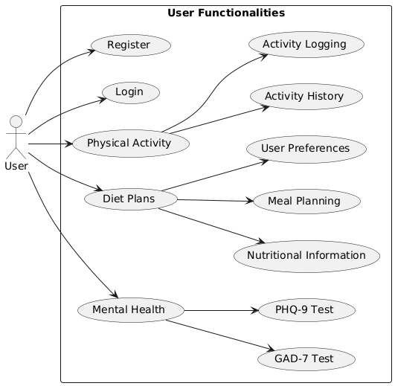
Use-case

Slide 7
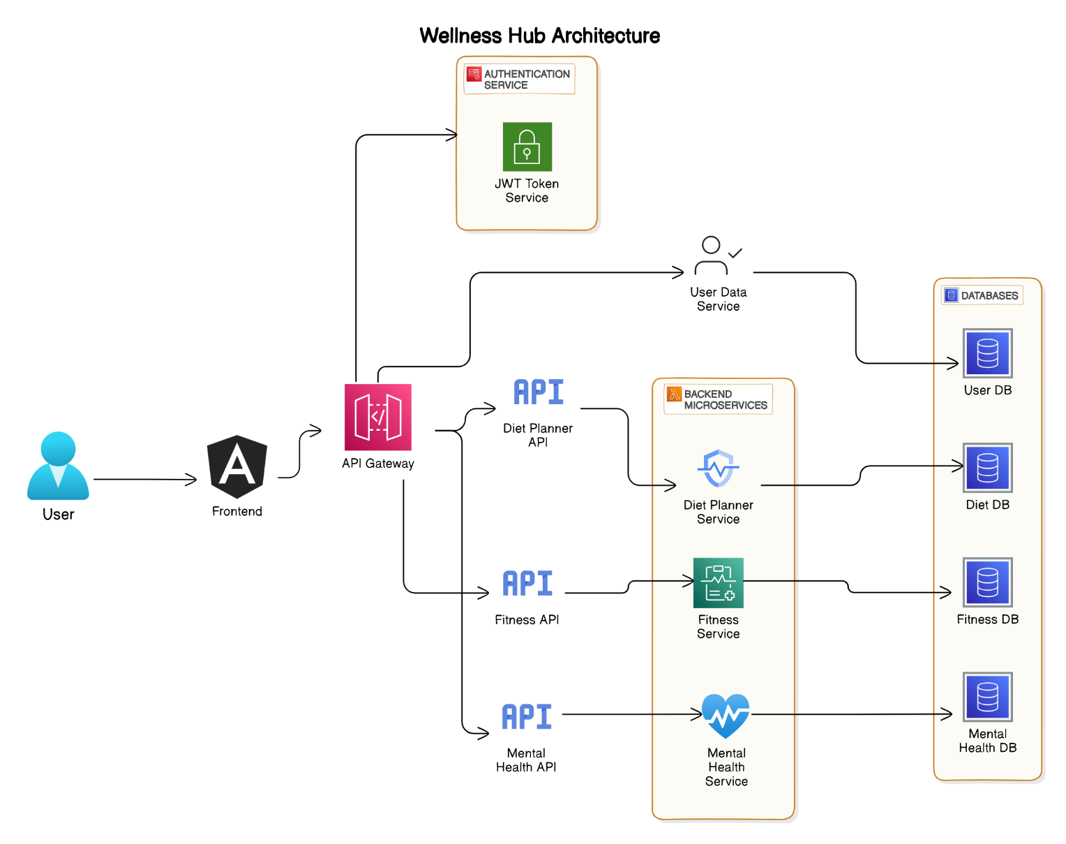
architecture

Slide 8
Thankyou

